Slide 1


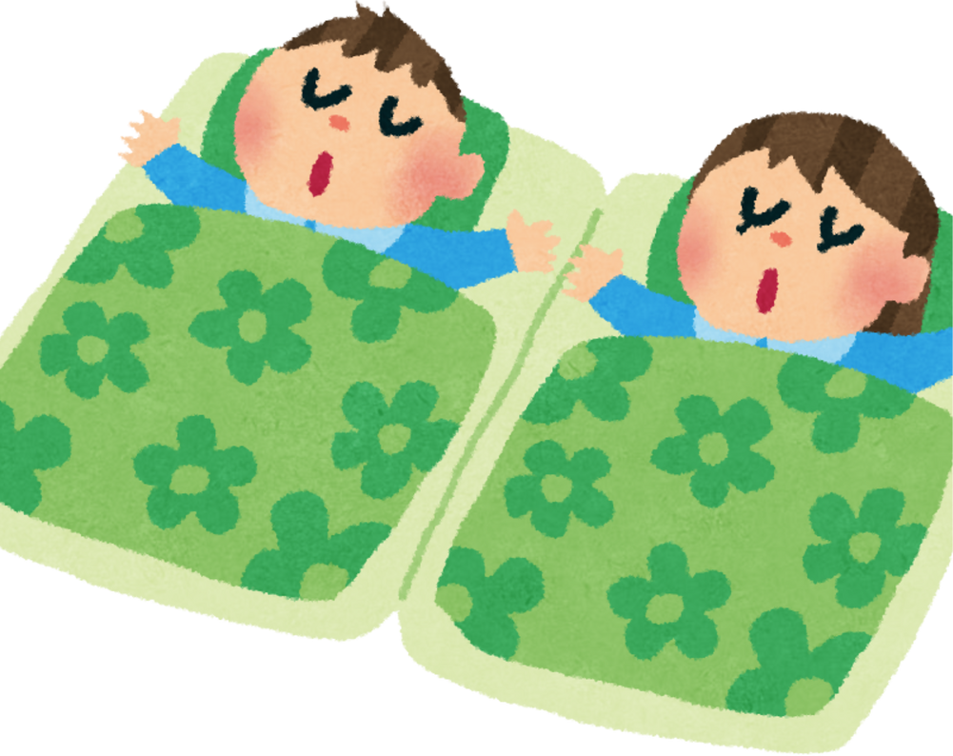
Sleep Workshop
Tower Hamlets Education Wellbeing Service

Slide 2

Who are we?
We are THEWS (Tower Hamlets Education Wellbeing Service) and we work in schools across Tower Hamlets helping children with their emotional wellbeing and mental health.
This includes teaching children strategies to help them manage their emotions.

Slide 3


What we will be covering today:
  What is sleep?
  Stages of sleep
  Common sleep difficulties and the impact
  Sleep and neuro-developmental conditions
  Sleep hygiene for a better nights sleep

Slide 4

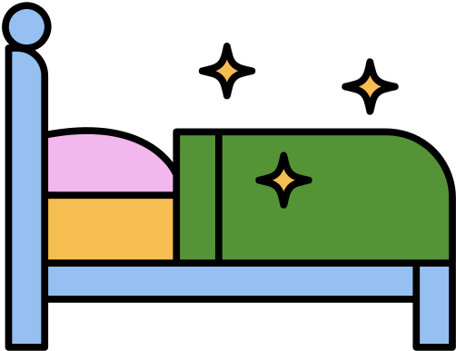
What is sleep and why do we do it?
Sleep is a natural state of rest and inactivity where the brain and body are partially inactive but not completely
Sleep restores energy, repairs injuries and illness, supports growth, psychological well-being and mood, concentration, memory, work performance and getting along with others.
Everyone has a different number of hours of sleep that they are able to function on, but there are baseline guides for children and teenagers

Slide 5

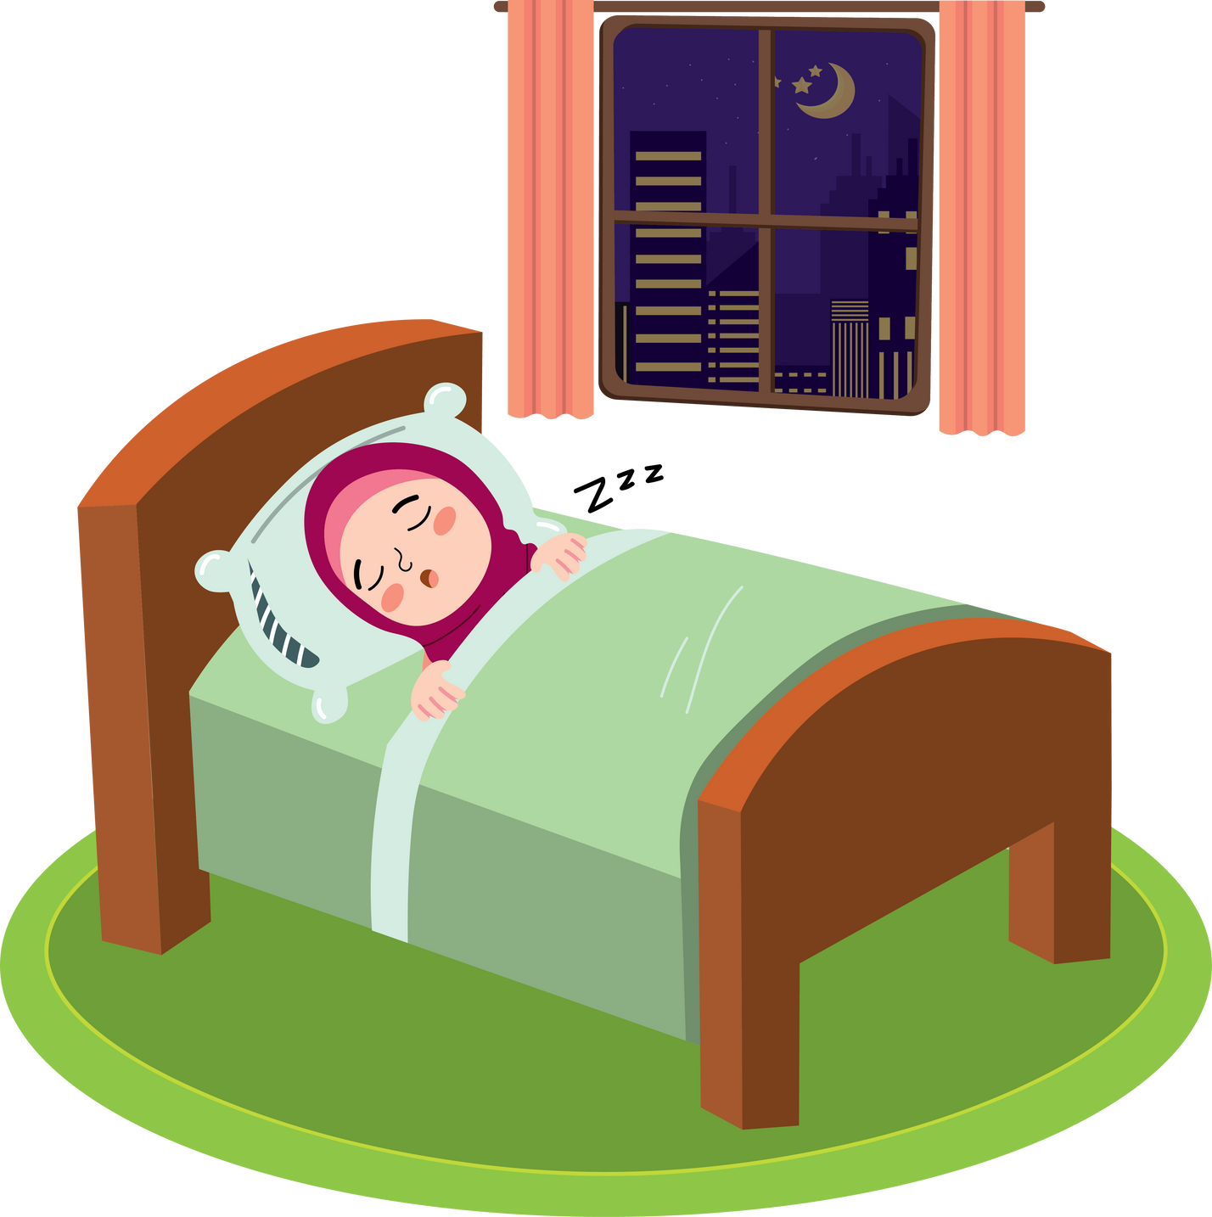
Baseline Guides for Sleep in Children
3-5 YEARS | 10-13 HOURS
6-13 YEARS | 9-11 HOURS
TEENS | 8-10 HOURS
These are just a baseline - not every child will need the same amount of sleep

Slide 6

The 5 Stages of Sleep

Slide 7

Common Sleep Difficulties
Anxiety and Stress:
Separation anxiety, worries, fears, and
other life pressures can keep children up at night
Bad sleep hygiene/ no bedtime routine:
Calm and consistent bedtime routines are important, if children are not having structured and calm bedtime routines this can cause sleep problems
Nightmares and night terrors:
Can be caused by being overtired or unwell or after watching something frightening. They can also sometimes be a sign of a more serious underlying mental health difficulty, e.g. anxiety, PTSD

Slide 8
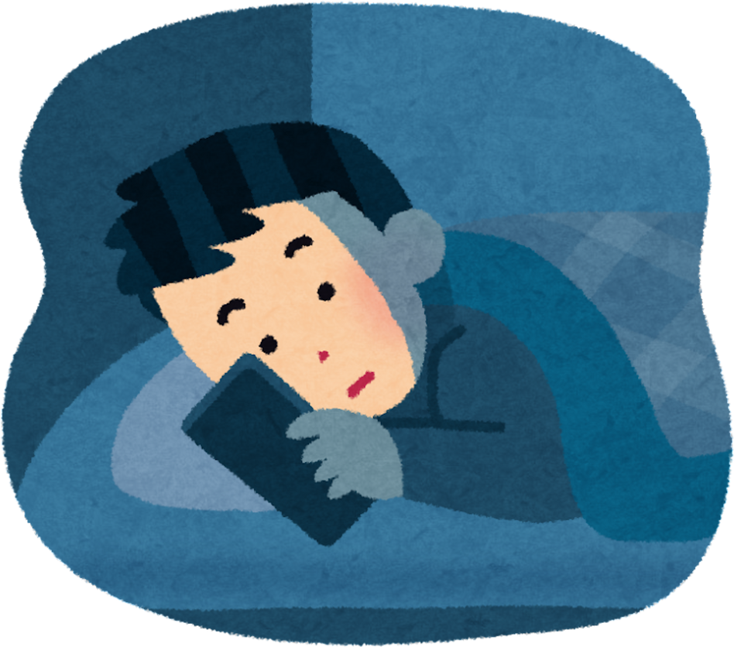
How do you think lack of sleep impacts children?

Slide 9



Reduced immune system functioning
Low Mood
Lack of Sleep
Lack of motivation/poor attention span
Poor memory
Conlict in relationships
Poor physical coordination

Slide 10


How sleep deprivation can affect learning
Memory and Retention:
Children may struggle to retain new
information and may forget
instructions given
Concentration and Attention:
Children may struggle to concentrate
and zone out during lessons
Emotional Regulation:
Children can be more prone to mood swings
Academic Performance:
Due to lack of focus, academic performance can drop - children may struggle more with comprehension
Social Interactions:
Children may be too fatigued to engage in social interactions which can impact their development through play

Slide 11

Sleep is crucial for emotional wellbeing
Activity/Exercise
Social/leisure activities
Balanced diet
Hygiene
Sleep

Slide 12
Sleep and Neuro-developmental conditions
Problems with sleep are twice as common among autistic children as they are among non-autistic children or those with other developmental conditions.
Anxiety
Sensory Differences
Autistic young people tend to ruminate about the events of the day, making it difficult to switch off and wind down.
Sensitivity to light, sound, temperature and touch can disrupt sleep.
Hormones
Regulation of the melatonin hormone for autistic people, and cortisol hormone for ADHD may make sleep difficult.

Slide 13


Tips for supporting neurodivergent young people with sleep
Explain sleep
Children may not understand why we need to sleep. Explaining the function of sleep can be helpful. Use social stories and visual cues if needed
Establish a reassuring routine
Make the bedtime routine consistent and familiar. Use visual cues and routine charts to support your child’s routine - avoid stimulating activities. Autistic children tend to like predictability
Adjust your expectations - a lot of autistic and neurodivergent children need fewer hours of sleep per night in order to function - if they are not tired at their current bedtime, try putting them to bed a bit later

Slide 14




Tips for supporting neurodivergent young people with sleep
Keep a sleep diary
Sleep diaries can be used to establish any unusual patterns of sleep and identify factors which may be influencing your child’s ability to sleep
Help your child to feel more comfortable
Dim the lighting and keep noise to a minimum. Earplugs or white noise can be helpful.
Remove labels from pyjamas and keep the room at comfortable temperature. These will all help with sensory overload

Slide 15

Sleep Hygiene
Sleep hygiene is how we can describes a person’s good sleeping habits.
Just like personal hygiene, everyone can make an effort to have good sleep hygiene.
  Consistency around bedtime routine is crucial in supporting your child’s sleep hygiene.
  Developing a good bedtime routine for your child is also helpful (should include all the steps leading up to bedtime)
  Avoid interactive technology/ homework before bedtime

Slide 16
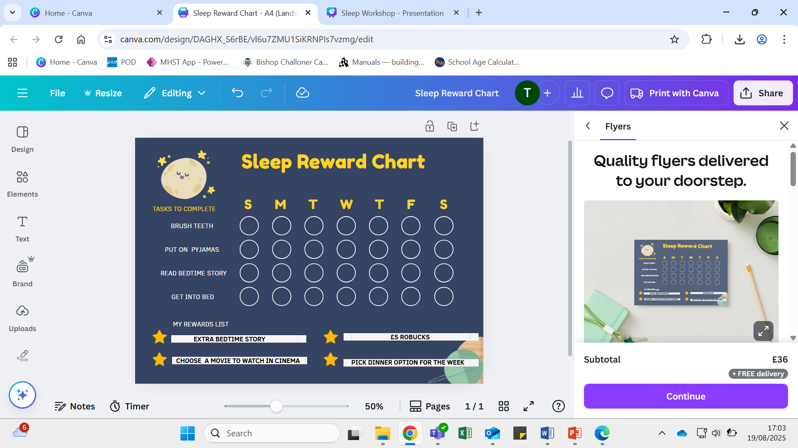
Sleep Reward Chart
Notes:
https://www.youtube.com/shorts/j2hMhXuw8rQ
Short video as an example of visual bedtime routine/ reward chart.
Sleep reward charts are useful to reinforce and make a new sleep routine/ sleep hygiene habits. You can make a sleep reward chart with your child and encourage them to choose their own rewards to boost incentive.

Slide 17


Tips to establishing a good Bedtime Routine
  Use interactive or overly stimulating technology.
  Consuming caffine or going to bed hungry.
  Having a warm bath.
  Nap after school or sleeping anywhere other than their bed.
  Set a quiet time 1 hour before bedtime
  Keep lighting dim.
  Encourage your child to exercise during the day.
  Have a cool bedroom temperature.
  Have your child sleep at the same time each night.
Notes:
Having a good bedtime routine is key to tackling common sleep problems.
Here are some do's and don'ts that can be helpful to keep in mind when trying to keep a good bedtime routine for your children.

Slide 18
Bedtime Routine- Room Sharing
Staggered Bedtimes
Create individual sleep zones
If children have different sleep needs, try putting them to sleep at different times.
Create separate sleep zones to
help your child personalise their
space.
Be flexible and patient
It might take some time for children to get used to sharing a room.
Try to set general expectations in sharing a room, but be realistic.
Establish a consistent bedtime routine
Make bedtime rewarding
Have a good, consistent bedtime routine for children who share a room
Having 1:1 time with your children separately can be rewarding, or use reward charts as reinforcement for the routine.
Notes:
https://www.nspcc.org.uk/keeping-children-safe/in-the-home/sharing-a-bedroom/#tips
It's common that some of your children may a share a room which can sometimes impact their sleep. These tips can be helpful in ensuring your children still have a good bedtime routine and reduce some tension/ problems that can occur with room sharing.
You can find more information about room sharing on the NPCC website, which also has information on rules about sharing a room regarding social housing.

Slide 19
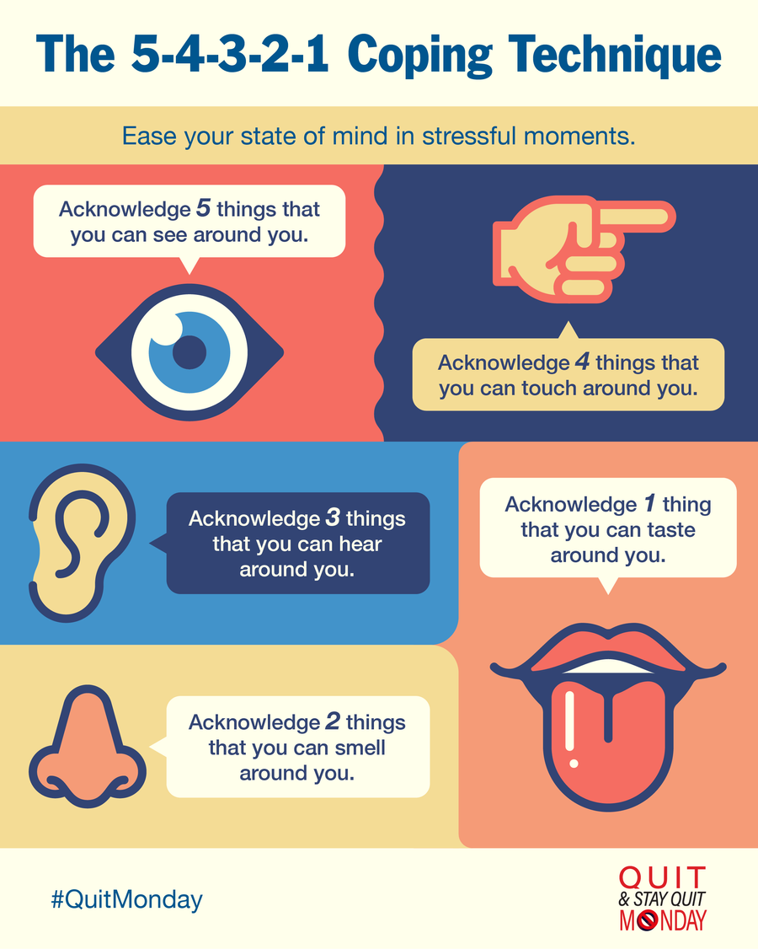
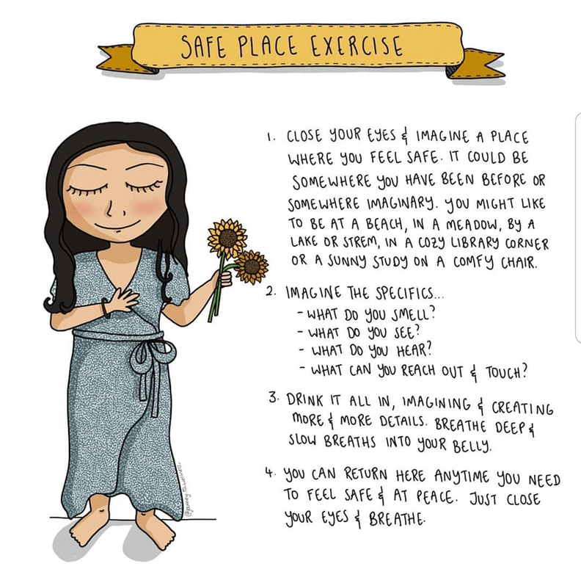

Relaxation Strategies
Notes:
Sometimes, children can experience nightmares or difficulty relaxing, especially if they are moving into their own room or regularly experience nightmares.
Here are some useful relaxation strategies to support your child when they are feeling anxious or having difficulty winding down.

Slide 20

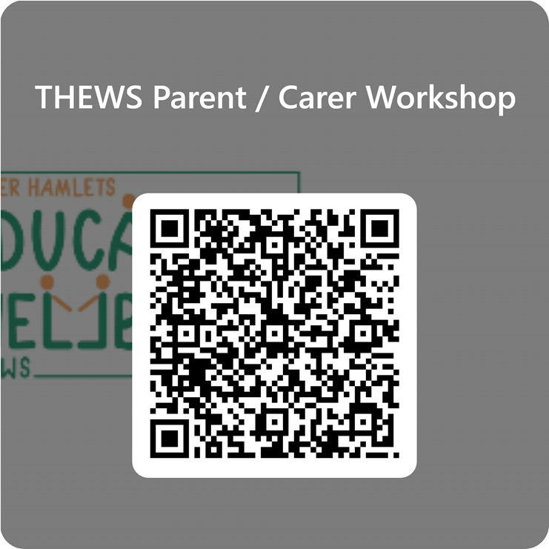
THEWS Feedback Form
Only takes 2 minutes to complete!
Bengali version available in the top right hand corner.
We value your feedback!

Slide 21



Further Support
  Speak to teachers/school for support or a referral to THEWS
  Parent advice helpline - 0808 802 5544
  NSPCC- Guidelines on children room sharing
  Autism Central Guidance on Sleep
  Book: Sleep Problems
Notes:
THEWS offer 6-8 sessions to support parents whose children experience common sleep difficulties. The sessions are more in depth and supports developing a sleep routine.
THEWS use a guided self-help book called Sleep Problems available to purchase online.
The national sleep helpline is open 24/7 to support with sleep.
The sleep charity supports families and individuals experiencing common sleep difficulties. They also have interactive resources such as sleep diaries, relaxation techniques and an e-book.
Autism Central is an online platform to support parents of autistic children. Offer further resources on supporting sleep.

Slide 22
Thank you
Any Questions?

